Slide 1
Using tools efficiently How to get the best out of tools and avoid unnecessary effort 1. garden hoes

Slide 2
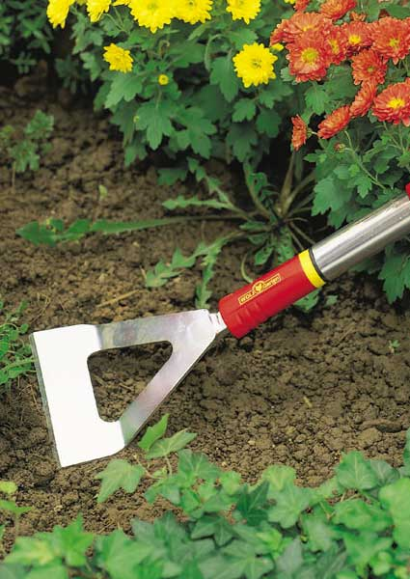
Dutch hoes are NOT for digging!
Dutch hoes are designed to sit on the surface of the soil and just glide below the surface to cut off the stems of weeds. Blades should be sharpened regularly.
However the angle of most hoe blades to the handle is very shallow – this encourages you to hold it at the wrong angle and dig in, making hoeing hard work.

Slide 3
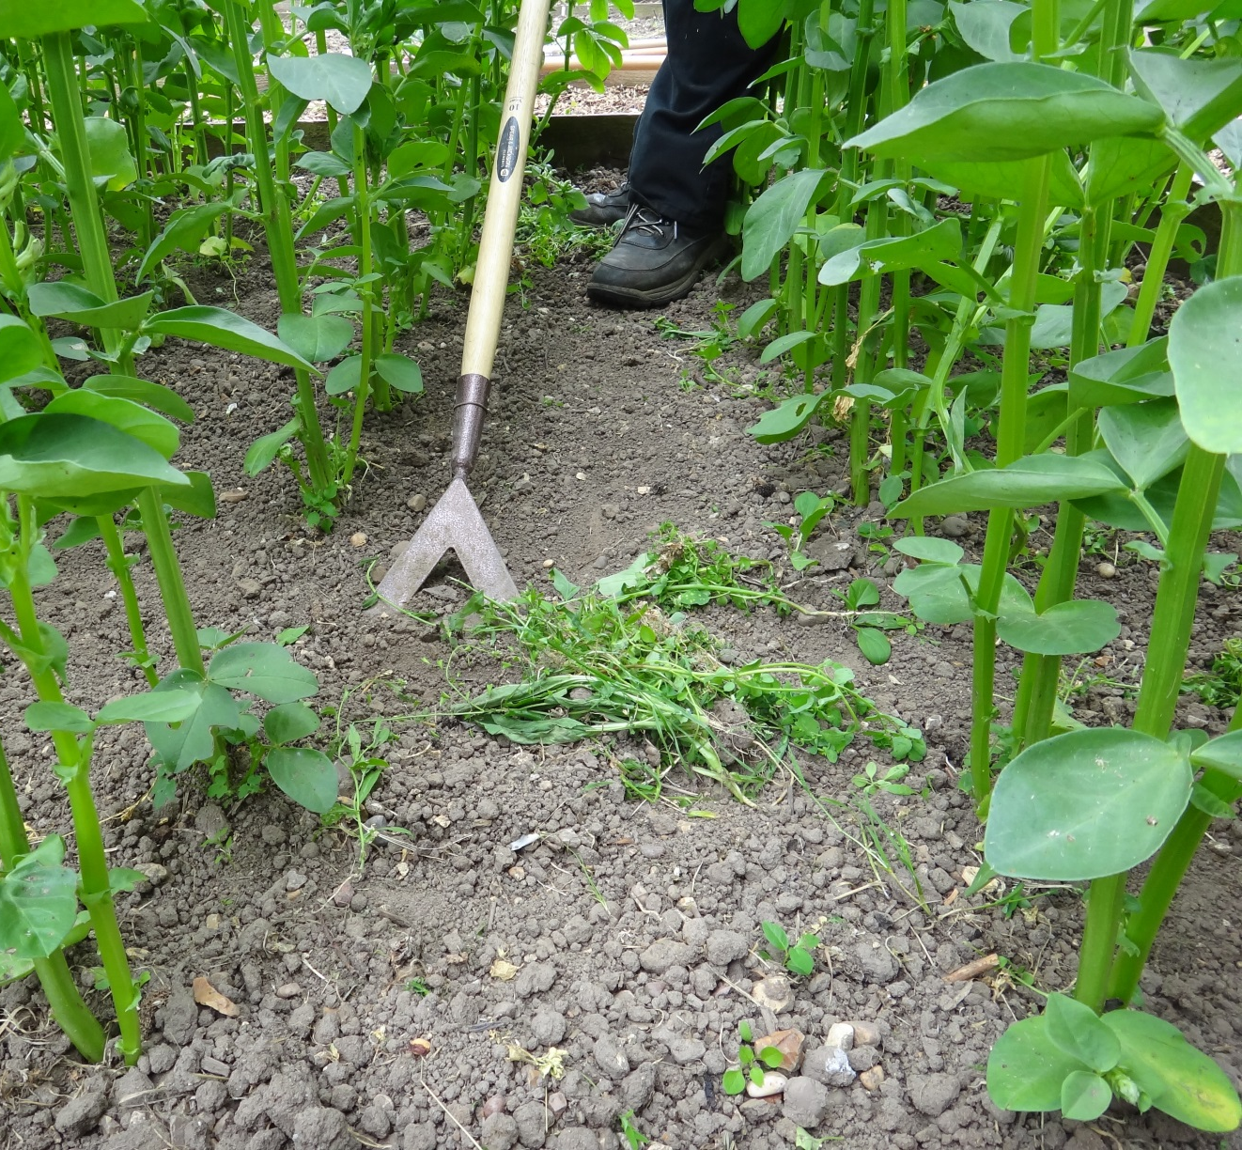
Correct hoeing action
You may have to bend your back to get the hoe at the correct angle to work just under the surface – if your hoe isn’t stainless steel, think about bending the angle of the head to the shaft slightly to make it more comfortable to use.
Notes:
You can bend a steel hoe head carefully to a by placing it in a vise and leaning on it, very gradually. or placing the head in the gap between two paving slabs. Don’t try this with stainless steel at all – it won’t bend but will break at the joint, the weakest point.

Slide 4
Using a dutch hoe

Slide 5
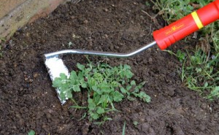
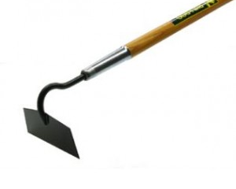
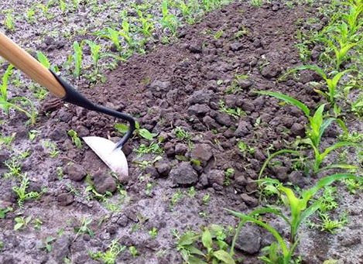
Draw hoes – beet, swan-neck, ‘swoe’ .
Draw hoes are used for seed drills and for weeding – a sharp edge is essential.
Widths vary -
originally to suit
different row spacings for crops.
Established weeds can be ‘chopped’ through by the blade, but if you hoe regularly you only need to ‘draw’ the blade across the soil surface to remove weed seedlings.

Slide 6
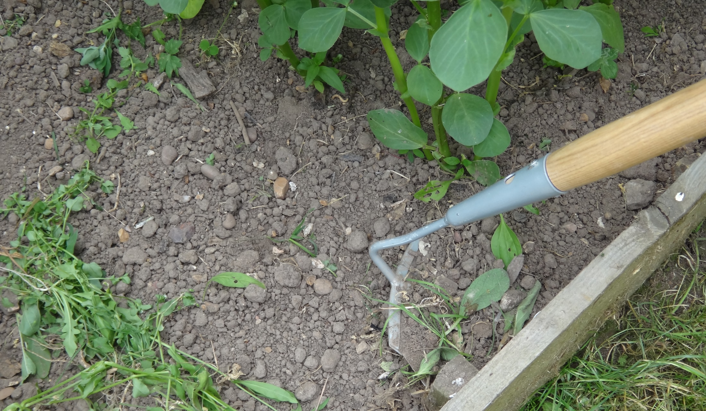
Using a draw hoe

Slide 7
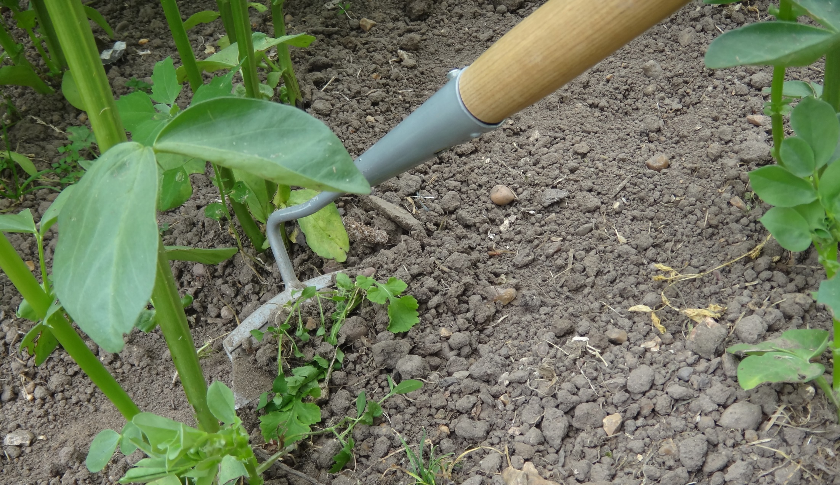
Draw hoes :fitting between plants as well as between rows

Slide 8
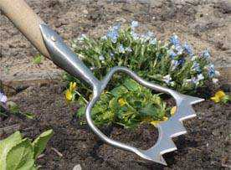
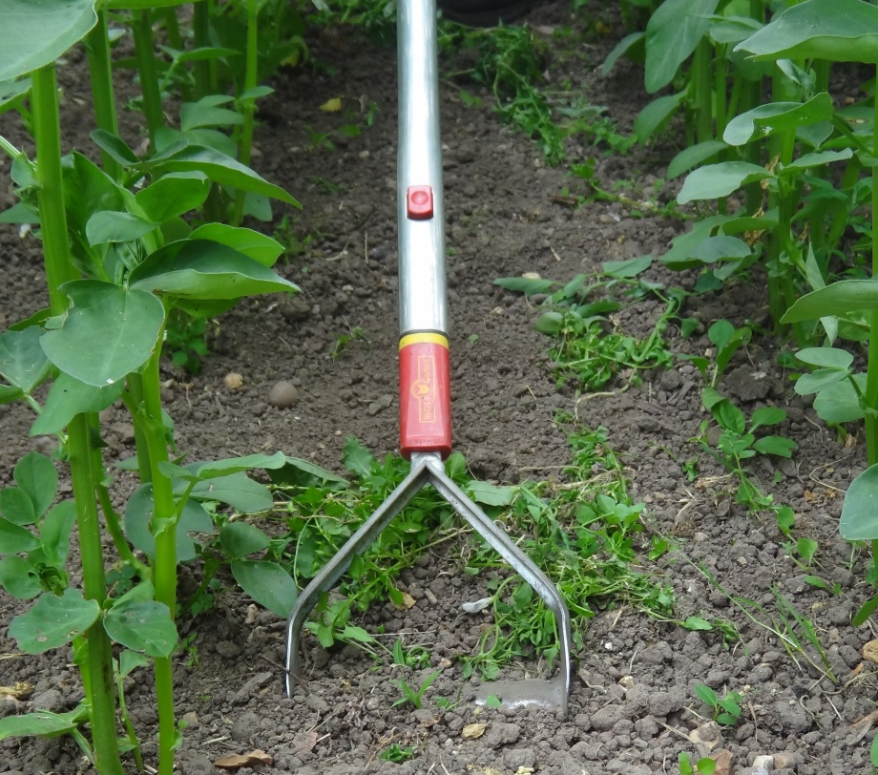
Variants – push-pull, ‘stirrup’, etc
Some variants have a double-edged blade, or a triangular one, so that you can cut through on both push and pull strokes for greater efficiency.
Also blades are often serrated to help the cutting action.

Slide 9
Using a push-pull hoe
Exit powerpoint presentation to stop!

